Slide 1
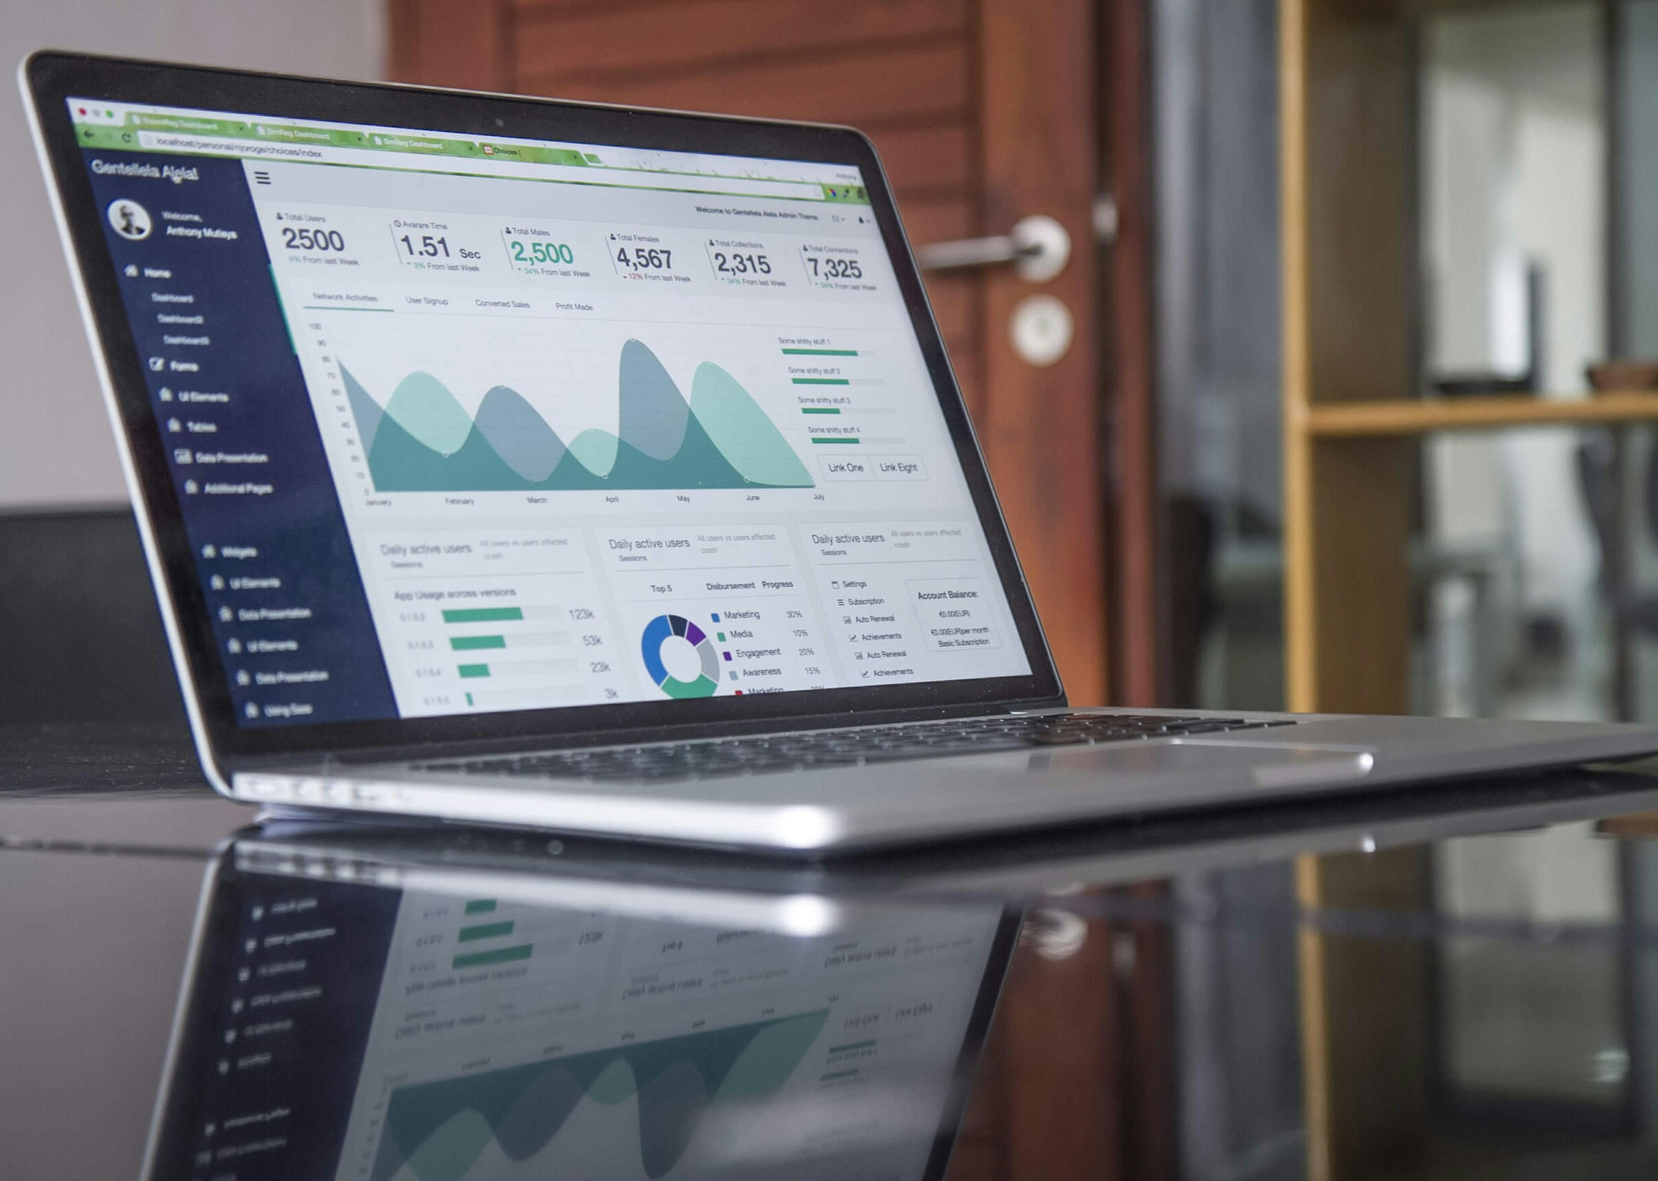



PRESENTED BY
Customer Shopping Behavior Analysis
By - Prince Kaushik

Slide 2




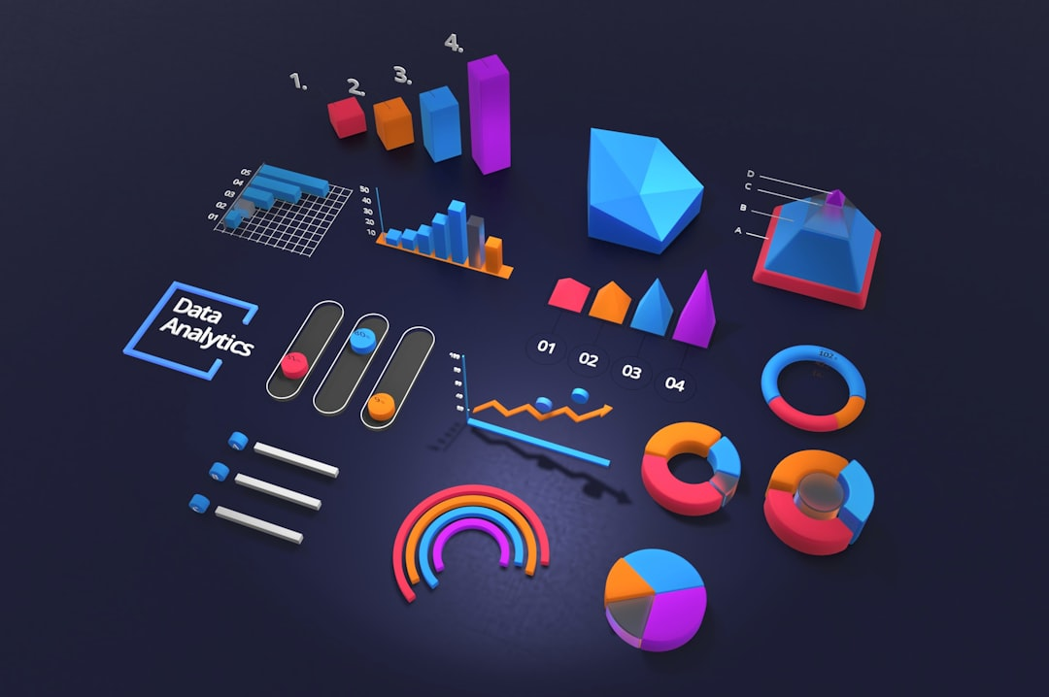

Customer Shopping Behavior Analysis
This presentation delves into the comprehensive analysis of customer shopping behavior, utilizing data-driven insights to enhance marketing strategies and improve customer engagement. By examining a dataset of 3,900 rows, we explore key metrics such as revenue by gender, product positioning, and customer segmentation. Our findings aim to inform business decisions and optimize sales performance through targeted marketing and effective loyalty programs.

Slide 3



Customer Shopping Behavior Analysis
Project Objectives
Data Utilization
Analyze customer shopping behavior to enhance marketing strategies and improve customer engagement through data-driven decisions and insights from 3,900 data rows.
Utilized a dataset of 3,900 rows to derive comprehensive insights, focusing on exploratory data analysis and SQL for effective business transaction analysis.
Expected Outcomes
Aim to improve sales and customer engagement by leveraging data insights, ultimately enhancing marketing strategies and customer loyalty programs.

Slide 4


Data Preparation Steps
Dataset Import
Initial Data Exploration
Missing Data Handling
Utilized pandas to import a dataset containing 3,900 rows, enabling efficient data manipulation and analysis for customer shopping behavior insights.
Executed df.info() to assess data structure and .describe() for summary statistics, revealing key metrics such as mean, median, and standard deviation.
Identified null values in the Review Rating column and imputed missing entries using the median rating for each product category, ensuring data integrity.

Slide 5
Feature Engineering Insights
Age Group Creation
Purchase Frequency Analysis
Developed an age_group column by binning customer ages into categories, enhancing segmentation for targeted marketing strategies and improving customer insights.
Created purchase_frequency_days from transaction data, allowing for better understanding of customer buying patterns and optimizing inventory management.
Data Consistency Verification
Ensured data consistency by verifying discount_applied and promo_code_used, which improved the accuracy of promotional effectiveness analysis.

Slide 6
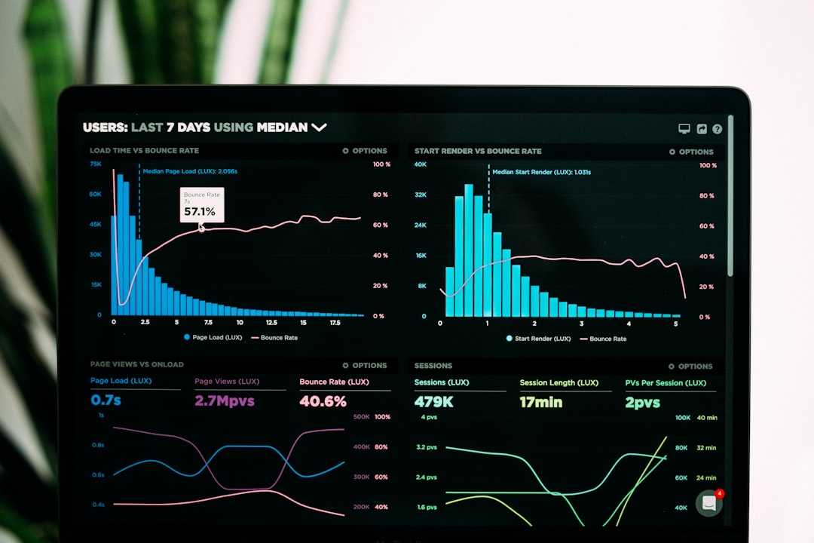
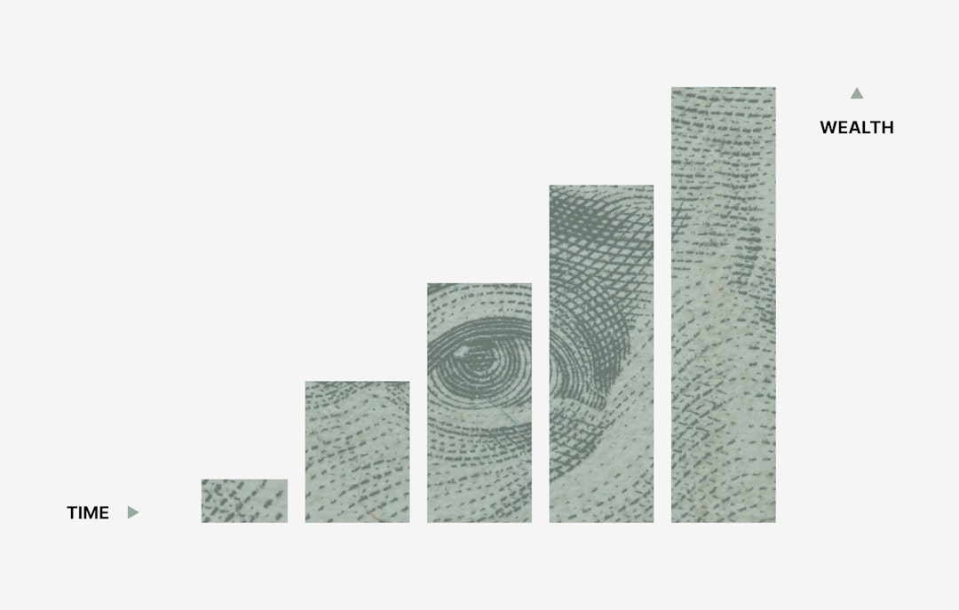

Revenue Analysis by Gender
Total Revenue Comparison
Spending Trends Identified
SQL Data Extraction
Analyzed total revenue generated by male customers at $1.2M and female customers at $1.5M, indicating a 25% higher spending by females.
Found that female customers tend to spend 15% more on average per transaction compared to male customers, highlighting differing purchasing behaviors.
Utilized SQL queries to extract gender-specific revenue data, ensuring accurate insights for targeted marketing strategies and business decisions.
Made with SlideMaker.app

Slide 7
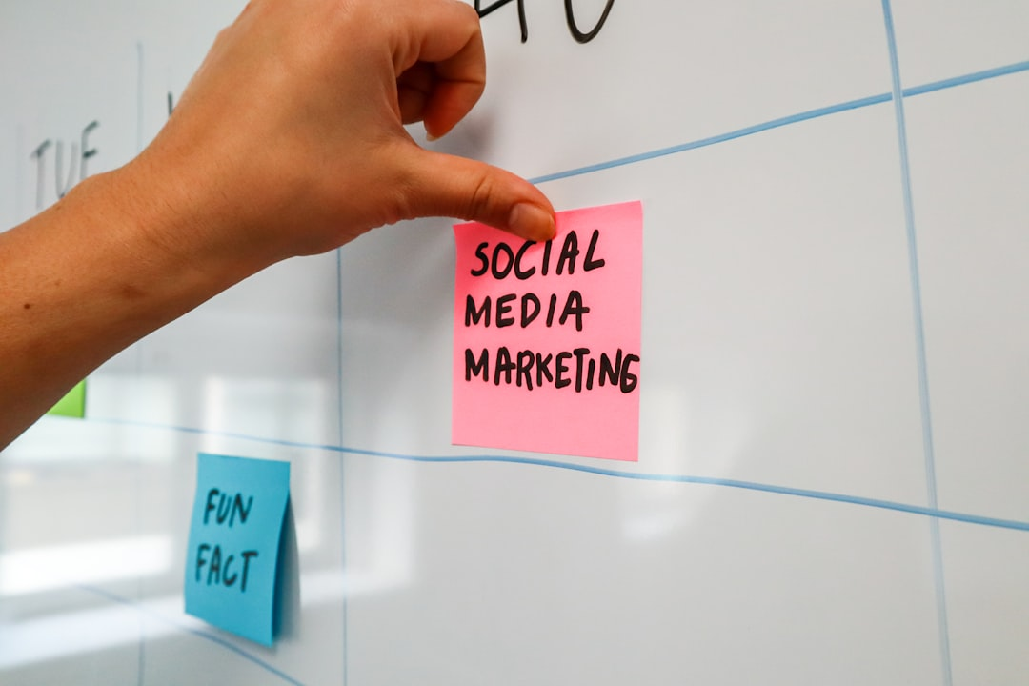
Customer Segmentation Insights
Customer Categories Defined
Spending Behavior Analysis
Segmented customers into New, Returning, and Loyal categories to tailor marketing strategies effectively, enhancing engagement and retention rates across demographics.
Analyzed spending behavior of each segment, revealing that Loyal customers contribute 60% of total revenue, guiding targeted marketing efforts for maximum impact.
High-Spending Discount Users
Identified high-spending discount users, representing 25% of customers, for targeted promotions, increasing conversion rates and boosting overall sales performance.

Slide 8
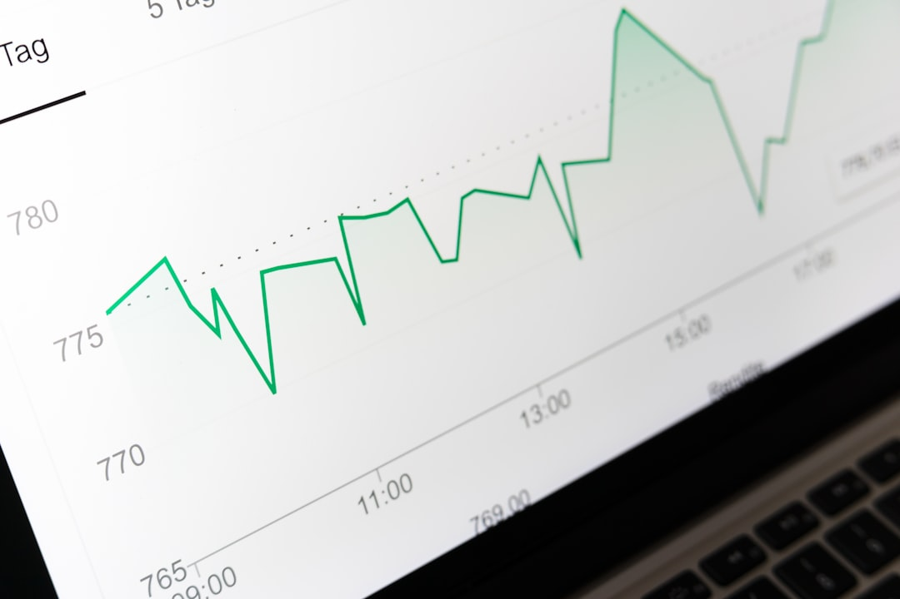
Discount Policy Review
Evaluate Discount Effectiveness
Identify Discount-Dependent Products
Reviewed discount policies to assess their impact on sales growth while ensuring margin control, leading to a balanced approach in pricing strategies.
Analyzed sales data to pinpoint products with high sales percentages reliant on discounts, allowing for targeted marketing and inventory management.
Recommend Profitability Adjustments
Suggested strategic adjustments to discount offerings based on sales performance metrics, aiming to enhance overall profitability without sacrificing customer engagement.

Slide 9

Dashboard Insights
Interactive Dashboard Development
Dynamic Data Exploration
Visual Analytics for Decisions
Created an interactive dashboard in Power BI to visually present insights, allowing stakeholders to engage with data in real-time and derive actionable conclusions.
Enabled stakeholders to explore data dynamically, facilitating deeper insights into customer behavior and trends, ultimately enhancing strategic decision-making processes.
Facilitated better decision-making through visual analytics, showcasing key metrics and trends that provide quick reference points for stakeholders during strategic discussions.

Slide 10
Business Recommendations
•
Promote Subscriber Benefits
Enhance loyalty by promoting exclusive benefits for subscribers, such as discounts and early access to sales, which can increase retention rates by 20%.
•
Target High-Revenue Age Groups
Focus marketing efforts on age groups contributing the most revenue, particularly those aged 25-34, who represent 35% of total sales.
•
Enhance Targeted Marketing
Develop targeted marketing strategies for express-shipping users, as they spend 15% more on average than standard shipping customers.
•
Review Discount Policies Regularly
Regularly assess and adjust discount policies to balance sales boosts with margin control, ensuring profitability while attracting customers.

Slide 11
Future Directions
1
2
3
Monitor Customer Behavior
Integrate Data Sources
Update Dashboard Regularly
Continuously track customer shopping patterns to identify emerging trends and adapt strategies accordingly, ensuring alignment with market demands and consumer preferences.
Incorporate additional data sources, such as social media and customer feedback, to gain deeper insights into customer preferences and enhance decision-making processes.
Ensure the Power BI dashboard is updated with new findings and metrics to provide stakeholders with the most current insights for informed business strategies.
Made with SlideMaker.app

Slide 12






Key Takeaways
In summary, our analysis revealed significant insights into customer shopping behavior, including revenue disparities by gender and the impact of discounts. We recommend enhancing customer loyalty programs and targeted marketing strategies to boost engagement. Moving forward, leveraging data-driven decisions will be crucial for optimizing sales and improving customer satisfaction. Let's embrace these insights to drive future growth and innovation.

